Slide 1
Biodiversity Capstone Project
A dive into wooly data

Slide 2
Overview
We have collected two sets of data:
Species_info - pertains to species’ endangerment status
Observations - pertains to species’ sightings in parks
Ahead, we will investigate which categories of species are most likely to be endangered as well as aid with a study of sheep in national parks.

Slide 3
Dataset Breakdown: species_info
Category - Category of species
String value
7 unique categories i.e. mammal
Scientific name - Proper scientific name of species
String value
5541 unique species i.e. Bos bison
Common name - Commonly referenced name of species
String value
Key/value pair with scientific name i.e. American Bison
Conservation status - Species’ conservation description
String value
Candidate for enum
Has nulls
i.e. Species of Concern, Endangered

Slide 4
Categories of Species
Conservation Statuses
Reptile
Fish
Amphibian
Vascular Plant
Mammal
Nonvascular Plant
Bird
Endangered
In Recovery
Threatened
Species of Concern
Null or ‘No Intervention’

Slide 5
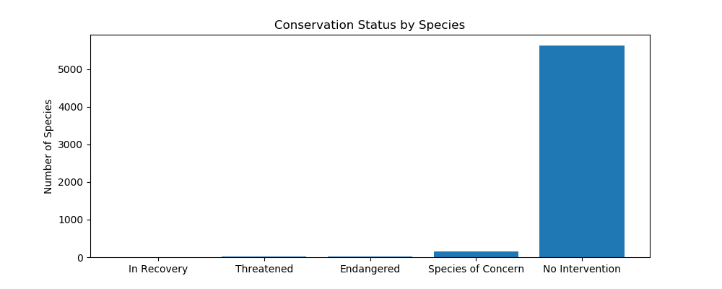
Endangerment Status By Species
Conservation Status | Number of Species
In Recovery | 4
Threatened | 10
Endangered | 16
Species of Concern | 161
No Intervention | 5633

Slide 6
Endangerment Status By Species - Recap
An overwhelming majority of species require no intervention
Although majority of the samples are here, for our scope, these can be considered the outliers
Any species not in ‘No Intervention’ have been dubbed ‘protected’
Status ‘Species of Concern’ has a full magnitude more than the next highest status count
Of 191 species that do not require intervention, only 4 of them are ‘In Recovery’

Slide 7
Mammalian Extinction?
Category | Not Protected | Protected | Percent Protected
Amphibian | 72 | 7 | 0.088608
Bird | 413 | 75 | 0.153689
Fish | 115 | 11 | 0.087302
Mammal | 146 | 30 | 0.170455
Nonvascular Plant | 328 | 5 | 0.015015
Reptile | 73 | 5 | 0.064103
Vascular Plant | 4216 | 46 | 0.010793
17.0% of mammals sampled are protected
176 unique species recorded
15.4% of birds sampled are protected
488 unique species recorded
Is it true that mammals are more likely to be endangered than birds?

Slide 8
No Mammalian Extinction.
We have multiple categories, so we will perform a Chi Squared Test
We formed a Null Hypothesis that mammals are more likely to be endangered than birds
Performing a Chi squared test of the following contingency table yields a P Value = 0.6876
P Value > .05 ; insignificant difference. This means we reject the Null Hypothesis that Mammals are more likely to be endangered than Birds.
+1 for humanity!
 | Protected | Not Protected
Mammal | 30 | 146
Bird | 75 | 413

Slide 9
You’re Hot and Then You’re Cold..
We have multiple categories, so we will perform a Chi Squared Test
We formed a Null Hypothesis that mammals are more likely to be endangered than birds
Performing a Chi squared test of the following contingency table yields a P Value = 0.03834
P Value < .05. This means we accept the Null Hypothesis that Mammals are more likely to be endangered than Reptiles.
+1 for Alien Overlords
 | Protected | Not Protected
Mammal | 30 | 146
Reptile | 5 | 73

Slide 10
Conservationist Actions
While species of birds are not the most endangered by percentage, they total for more endangered species than all other non-plants combined!
Only 4 total species of all samples are considered ‘In Recovery’
Let’s build a bird sanctuary where multiple species of endangered birds can cohabitate and thrive!

Slide 11
Dataset Breakdown: observations
Scientific_name - Proper scientific name of species
String value
No nulls
i.e. Prunus subcordata
Park_name - Name of park where species was observed
String value
No nulls
i.e. Yosemite National Park
Observations - Number of times observed in the park
Int value
No nulls
i.e. 138

Slide 12
Hoof In Mouth... Ewe.
Scientists are studying the number of sheep sightings at different national parks
Our scientists know that 15% of sheep at Bryce National Park have foot and mouth disease
Park rangers at Yellowstone National Park have been running a program to reduce the rate of foot and mouth disease at that park
The scientists want to test whether or not this program is working.
How many weeks are needed to observe at Yellowstone National Park to observe enough sheep?

Slide 13
Determining Sample Size
The scientists need to test whether or not this program is working.
They want to be able to detect reductions of at least 5%.
15% Yellowstone Sheep are known to have the disease
Minimum Detectable Effect desired = 100 x 0.05 / 0.15 = 33.3%
Using these numbers with the sample size calculator at Optimizely, yields a necessary sample size of 510

Slide 14
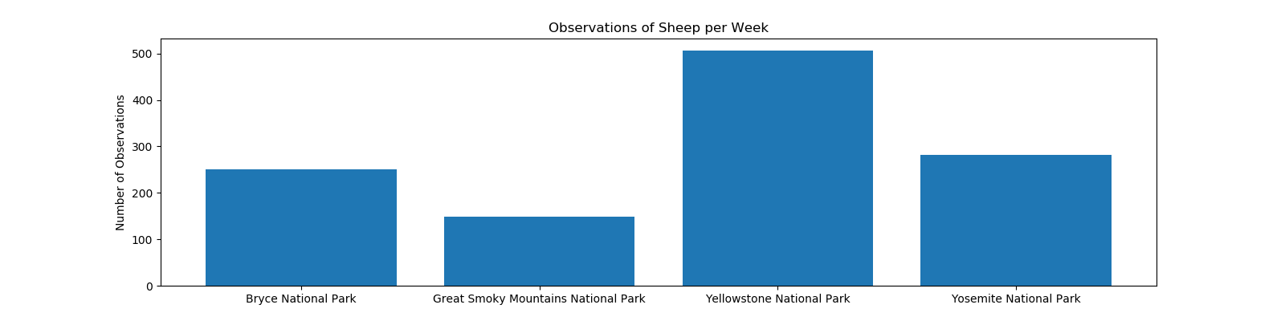
Not So Baaa-shful

Slide 15
Counting Sheep
How many weeks would you need to observe sheep at both Bryce National Park and Yellowstone National Park?
From the graph, we saw:
Bryce National Park = 250 observations / week
Yellowstone National Park = 507 observations / week
With a needed sample size of 510, we should allot the following time:
Weeks at Bryce = (510 observations) / (250 observations/ week) = 2.04 weeks => 2 weeks
Weeks at Yellowstone = (510 observations) / (507 observations/ week) = .994 weeks => 1 week

Slide 16
Questions? Comments? Applause?
Feel free to reach out to me on slack, @Corey Dwayne Thompson!
If you feel applause is in order, capture the moment in a .gif and post it to a thread on the slack channel! Alternatively, clap where you are, until I acknowledge you.
Thanks!

